Slide 1
Puppy Palaces and Requirements
Green Girls Robotics
Pacer STEM Club
November 2015

Slide 2
Today’s Agenda
Introduction
Ice Breaker Activity
Engineering & Project Managing
Project Introduction
Build Houses
Share Projects with group
Notes:
Corinn

Slide 3
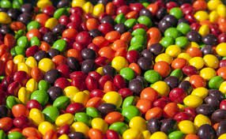
Skittles Icebreaker
Red : What do you want to learn about
Orange : What is something you are good at
Yellow : Describe yourself in three words
Green : Share your favorite food
Blue : Share a hobby of yours
Purple : Share your favorite color
Notes:
Erica

Slide 4
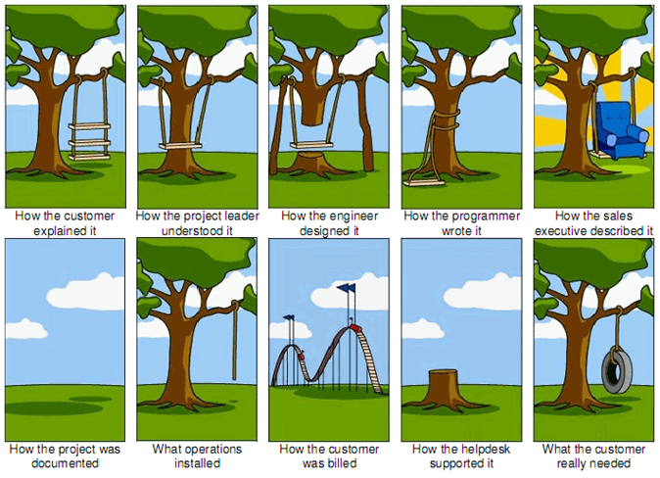
What Not to Do
Notes:
Claire

Slide 5
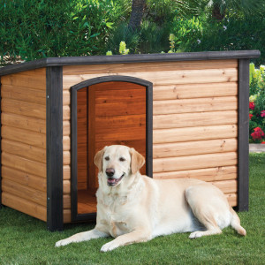
Puppy Palace Project
Meet the family
Hear their requirements
Build a dog house
Example
Notes:
Grace

Slide 6
Supplies
Construction paper
Scissors
Tape ( and lots of it)
Stickers
Markers
Post-it notes
Notes:
Corinn

Slide 7
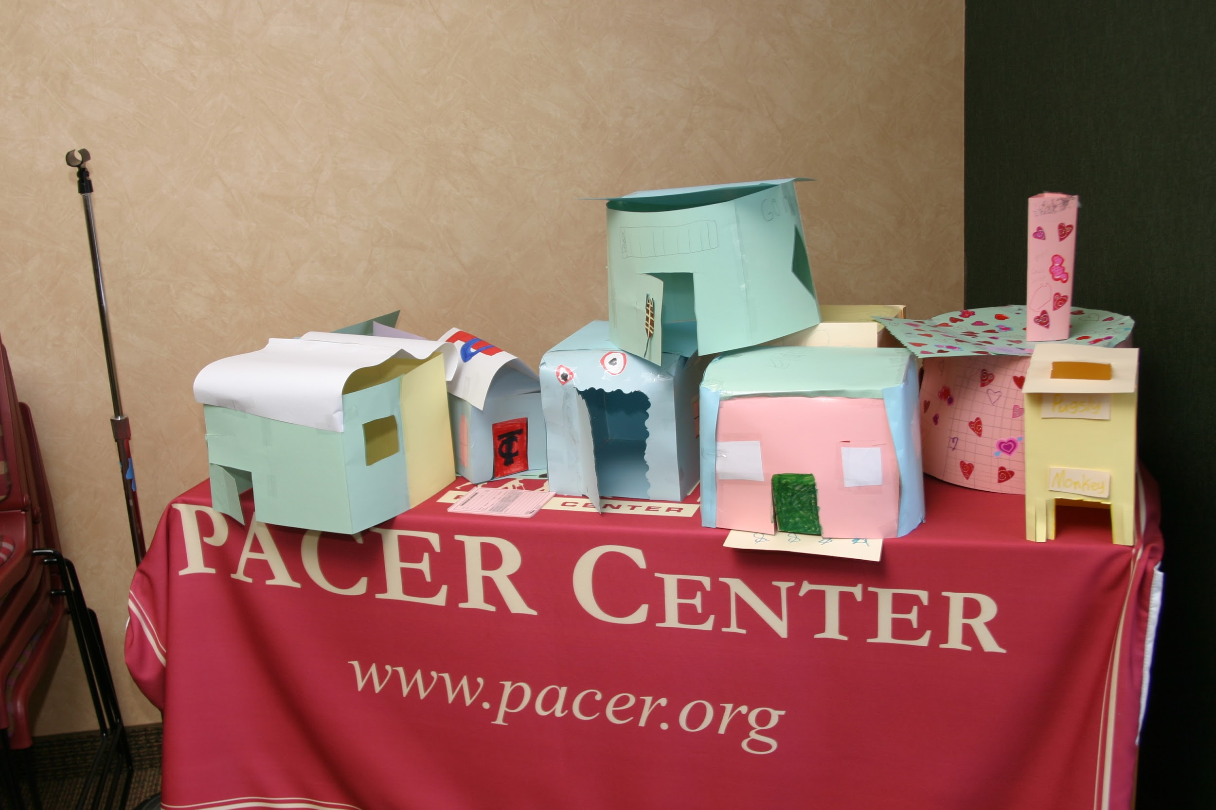
Building Your Dog Houses
Meet the requirements given
Be creative
Specialize
Examples
Notes:
Zoe

Slide 8
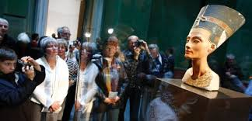
Share Your Houses
Museum walk through!
Notes:
Grace

