Slide 1
Breaking Down Problems Using the Work Breakdown Structure Green Girls Robotics Pacer STEM Club – Exite Camp August 2015

Slide 2
The Work Breakdown Structure
The work breakdown structure combines the engineering lifecycle with a simple plan for good time management to add simplicity to solving problems. You’ll include what number objective it is, as well as what your objective is and how long about it will take to achieve that objective.

Slide 3
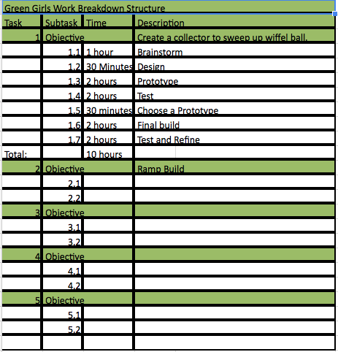
The Work Breakdown Structure
Task
Subtask
Time
Description
Total
Engineering Lifecycle

Slide 4
Breaking Down the Bowling Project
Task (Ex: 1,3, 6, etc.)
Subtask (Ex: 2.2, 5.4, 6.1, etc.)
Time (Ex: 30 minutes, 2 hours, etc.)
Description (Choose a prototype, test, etc.)
Total amount
of time it takes

Slide 5
Questions

